Slide 1

Towards Total Recall in Industrial Anomaly Detection
2022 IEEE/CVF Conference on Computer Vision and Pattern Recognition (CVPR)

Slide 2
Outline
Introduction
Method:
Locally aware patch features
Coreset-reduced patch-feature memory bank
Anomaly Detection with PatchCore
Experiments and Ablation Study
Conclusion

Slide 3
Introduction
Addressed problem: cold-start anomaly detection for visual inspection of industrial image data.
Out- of-distribution detection problem: where a model needs to distinguish between samples being drawn from the training data distribution and those outside its support.
One possible solution: to leverage common deep representations from ImageNet classification without adaptation to the target distribution.
Notes:
<1st line>
The cold start means, disability to provide something about which it has not yet gathered sufficient information. In this case it refers to anomalous samples.
Lets take the scenario where it is easy to acquire imagery of normal examples but costly and complicated to specify the expected defect variations in full.
Therefore, this task can be treated as an out- of-distribution detection problem where a model needs to be able to tell the difference between samples that come from the training data distribution and those that don't.
<3rd line>
Despite the missing adaptation, these models offer strong anomaly detection performance and even solid spatial localization of the defects. The key to those is to exploit the multiscale nature of deep feature representations

Slide 4
Introduction
PatchCore is an effective remedy:
maximizing nominal information available at test time
reducing biases towards ImageNet classes
retaining high inference speeds.
PatchCore Utilizes locally aggregated mid-level features patches.
Those features build up a memory bank.
PatchCore achieves state-of-the-art image-level detection scores on MVTec AD and MTD, with nearly perfect scores on MVTec AD (up to AUROC 99.6%),
Notes:
<2nd point>
This allows PatchCore to operate with minimal bias towards ImageNet classes on a high resolution, while a feature aggregation over a local neighbourhood ensures retention of sufficient spatial context.
<3rd point>
The memory bank allows PatchCore to optimally leverage available nominal context at test time.
<4th point>
It s able to reduce detection error of previous methods by more than half,

Slide 5
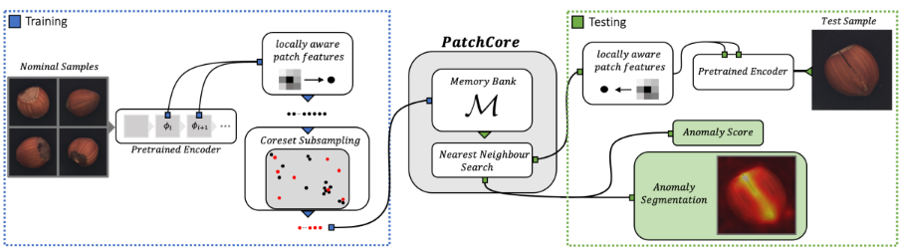
Method
The PatchCore method consists of several parts:
local patch features aggregated into a memory bank
a coreset-reduction method to increase efficiency
Algorithm that arrives at detection and localization decisions

Slide 6
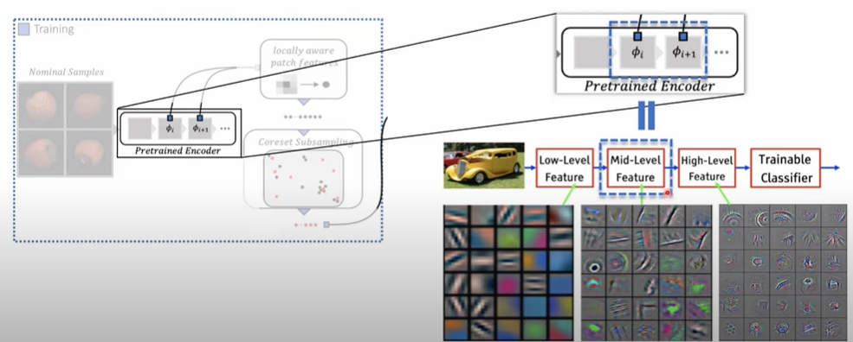
Locally Aware Patch Features
The memory bank comprises of mid-level features to avoid features too generic or too heavily biased towards ImageNet classification.
Feature slice at position h,w
Notes:
<2nd point>
φi,j = φj (xi) to denote the features for image xi ∈ X (with dataset X ) and hierarchy- level j of the pretrained network φ.
to denote the c ∗ -dimensional feature slice at positions h ∈ {1, . . . , h∗} and w ∈ {1, . . . , w∗}.
the choice of feature representation should be from the mid level as going further down the network hierarchy would introduce two problems:
Firstly, it loses more localized nominal information
Secondly, very deep and abstract features in ImageNet pretrained networks are bised towards the task of natural image classification, which has only little overlap with the cold-start industrial anomaly detection task and the evaluated data at hand.

Slide 7


Locally Aware Patch Features
Introduce local neighborhood aggregation to make sure each patch-representation operates on a large enough receptive field size to account for meaningful anomalous context
Those build up to a locally aware patch feature collection.
Notes:
The purpose is to increase receptive field size and robustness to small spatial deviations without losing spatial resolution or usability of feature maps.
<notation 1>
The notation from the previous slide is extended, incorporating feature vectors from the neighbourhood patches.
This is done by using an aggregation functions of feature vectors in the neighborhood centered at h and w with patchsize p.
Here, they use adaptive average pooling. This is similar to local smoothing over each individual feature map,
<notation 2>
There is a optional striding parameter which is set to 1

Slide 8

Locally Aware Patch Features
Aggregation of multiple feature hierarchies to increase performance
The PatchCore memory bank is defined as
Notes:
to retain the generality of used features as well as the spatial resolution, PatchCore uses only two intermediate feature hierarchies j and j + 1.
This is achieved by bilinearly rescaling the patch-feature collection at level j+1. I took a quick look at the implementation code and they use channel wise concatenation
Lastly the patchcore memory bank is defined as the union of all embeddings in feature collection

Slide 9
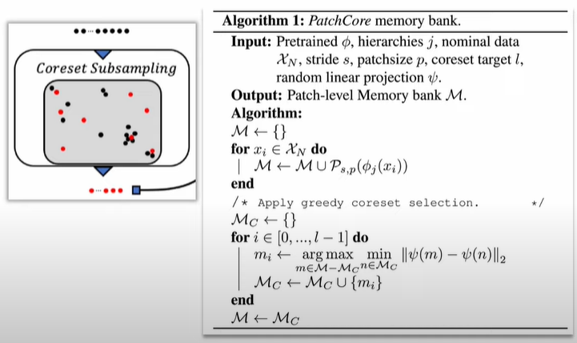
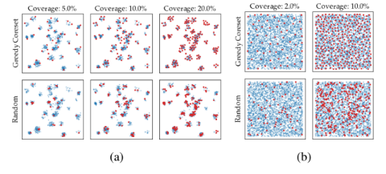
Coreset-reduced patch-feature memory bank
For increasing sizes of Nominal samples, PatchCore memory bank will become exceedingly large.
Use coreset subsampling (minimax facility location) to reduce the size of memory bank.
Notes:
<1st line>
And thus the inference time to evaluate novel test data and required storage will also increase.
<2nd line>
For the coreset subsampling the authors use facility location problem algorithm
<last picture>
This picture gives a visualization of the difference between using coreset and random sampling on a multimodal and uniform distribution

Slide 10
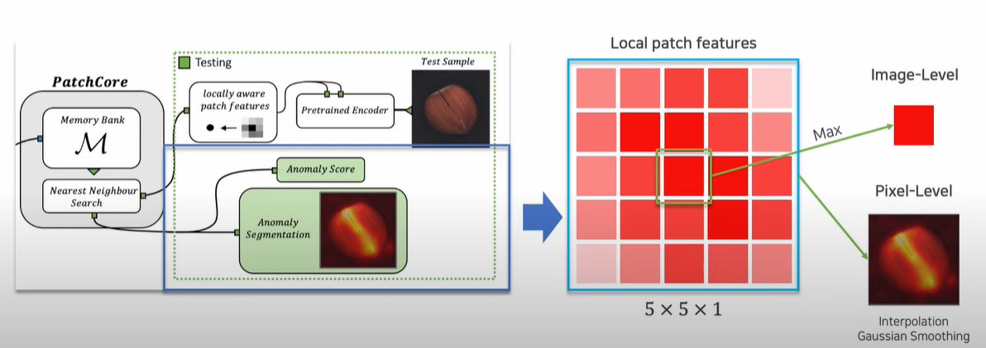
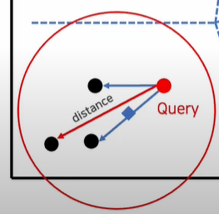

Anomaly Detection with PatchCore
Estimation of image-level anomaly score using the maximum distance score between test patch features to each respective nearest Neighbour.
Use scaling to account for the behavior if Neighbour patches.
Segmentation map can be computed in the same step by realigning computed patch anomaly scores based on their respective spatial location.
Notes:
<1st line>
The S* here is the maximum distance mentioned earlier the m test, * is the test patch features, and the m* is the respective nearest neighbor.
<2nd line>
The intuition behind this is If memory bank features closest to anomaly candidate m test,∗ , m∗ , are themselves far from neighbouring samples and thereby an already rare nominal occurrence, we increase the anomaly score
<3rd line>
we upscale the result by bi-linear interpolation. and smoothed the result with a Gaussian of kernel width σ = 4, but did not optimize this parameter.

Slide 11
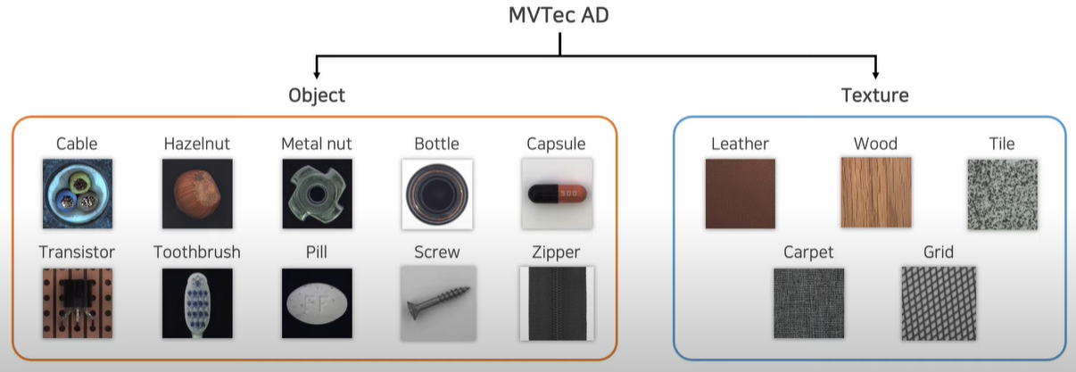
Experiments
Datasets:
MVTec AD: 5354 images (1725 test set), use nominal only training dataset
Magnetic Tile De- fects (MTD): with 925 defect-free (20% for test) and 392 anomalous images
MSTC : subsampled version of STC dataset, 12 scenes of pedestrian videos
Notes:
<3rd line>
Training videos include normal pedestrian behaviour while test videos can contain different behaviours such as fighting or cycling.

Slide 12
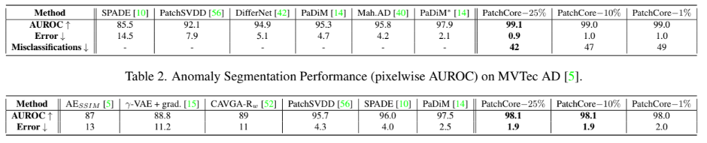
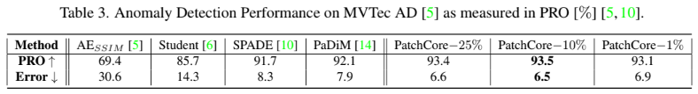
Results and Ablation study
Notes:
The tables also shows performance based on various levels of memory bank subsampling (25%, 10% and 1%).
The total misclassifications is the sum of the false-positive and false-negative predictions with F1-optimal threshold.
PatchCore achieves state-of-the-art anomaly segmentation, both measured by pixelwise AUROC (Table 2) and PRO metric (Table 3).
The PRO matric here stands for per region overlap, here we also threshold the anomaly score to obtain binary prediction, then the percentage of correctly predicted pixels is computer for each annotated defect region the ground truth. The average over all defect is the final PRO value.

Slide 13
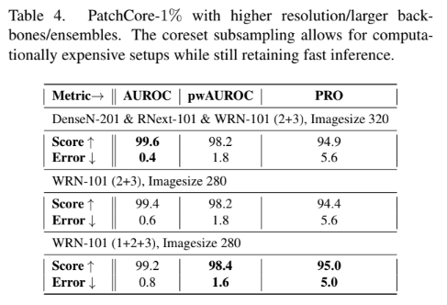


Results and Ablation study
(image AUROC, pixel AUROC, PRO metric).
Notes:
The author also try to apply PatchCore 1% on higher resolution images with larger backbone, it retains the inferences times less than PatchCore−10% on the default resolution.
<table 2>
pixel-level anomaly detection of PatchCore−100% (without subsampling) are lower than SPADE [10] but with higher performance.
But with the coreset subsampling the PatchCore can be made faster while retaining the state of the art performance.

Slide 14
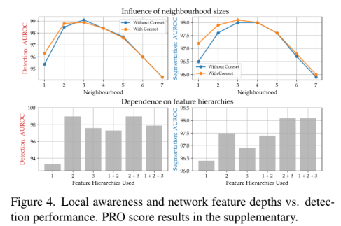
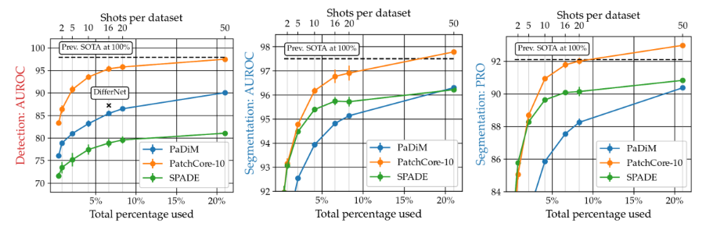

Results and Ablation study
Notes:
The author also investigated the importance of locally aware patch feature
<top>
The table shows a clear optimum between locality and global context for patch-based anomaly detection therefore motivating the uses of patch size 3
<bottom>
As we know global context can be achieved by moving down the network hierarchy, but at cost of reduced resolution and heavier imagenet bias.
<right>
On the right side of the image, is a sample efficiency graph to simulate the scenario of having access to limited nominal data is a relevant setting for real-world inspection. With amount of nominal samples varies from 1 to 50
<right bottom>
The last table shows the performance on the other 2 datasets we mentioned at the beginning, and for the mSTC which is the subsampled version of STC pedestian video data they make use of deeper network feature maps at levels 3 and 4 as the context is much closer to the natural image data. And it shows a good performance which suggest for good transferability of PatchCore to such domains.

Slide 15
Conclusion
This paper introduced the PatchCore algorithm for cold- start anomaly detection
PatchCore shows high effectiveness for industrial anomaly detection without the need to specifically adapt to the problem domain at hand
PatchCore strikes a balance between retaining a maximum amount of nominal context at test-time through the usage of memory banks and the 3 components:
local patch features aggregated into a memory bank
a coreset-reduction method to increase efficiency
Algorithm that arrives at detection and localization decisions
Notes:
<line 2>
applicability is generally limited by the transferability of the pretrained features leveraged.

Slide 16

Thank You :D

